Slide 1
Chapter 3
Style Sheets:
CSS
WEB TECHNOLOGIES
A COMPUTER SCIENCE PERSPECTIVE
JEFFREY C. JACKSON

Slide 2
Motivation
HTML markup can be used to represent
  Semantics: h1 means that an element is a top-level heading
  Presentation: h1 elements look a certain way
It’s advisable to separate semantics from presentation because:
  It’s easier to present documents on multiple platforms (browser, cell phone, spoken, …)
  It’s easier to generate documents with consistent look
  Semantic and presentation changes can be made independently of one another (division of labor)
  User control of presentation is facilitated

Slide 3
Style Sheet Languages
Cascading Style Sheets (CSS)
  Applies to (X)HTML as well as XML documents in general
  Focus of this chapter
Extensible Stylesheet Language (XSL)
  Often used to transform one XML document to another form, but can also add style
  XSL Transformations covered in later chapter

Slide 4
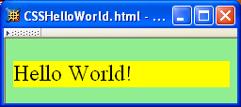
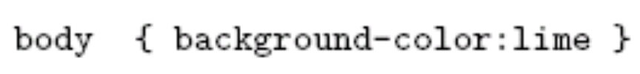
CSS Introduction
A styled HTML document
produced by the style sheet style1.css:

Slide 5
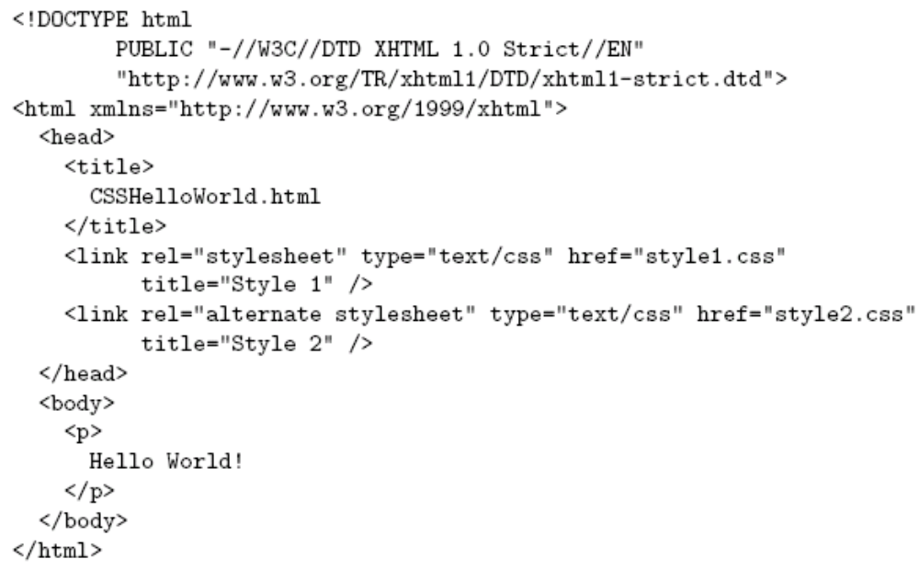
CSS Introduction
link element associates style sheet with doc.

Slide 6
CSS Introduction
type attribute specifies style language used

Slide 7
CSS Introduction
href attribute provides style sheet URL

Slide 8
CSS Introduction
title attribute provides style sheet name

Slide 9
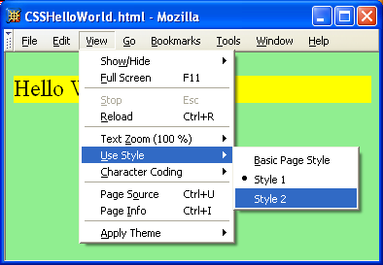
CSS Introduction

Slide 10
CSS Introduction
Alternative, user selectable style sheets
can be specified

Slide 11
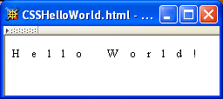
CSS Introduction
A styled HTML document
produced by the style sheet style2.css:

Slide 12
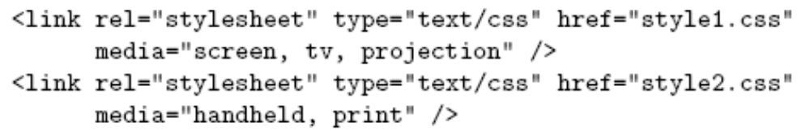
CSS Introduction
Single document can be displayed on multiple media platforms by tailoring style sheets:
This document will be printed differently than it is displayed.

Slide 13
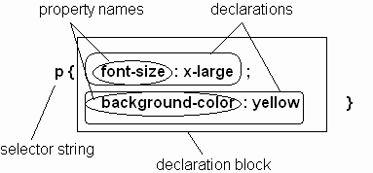
CSS Syntax
Parts of a style rule (or statement)

Slide 14

CSS Syntax:
Selector Strings
Single element type:
Multiple element types:
All element types:
Specific elements by id:

Slide 15
CSS Syntax:
Selector Strings
Single element type:
Multiple element types:
All element types:
Specific elements by id:
type selector

Slide 16
CSS Syntax:
Selector Strings
Single element type:
Multiple element types:
All element types:
Specific elements by id:
universal selector

Slide 17
CSS Syntax:
Selector Strings
Single element type:
Multiple element types:
All element types:
Specific elements by id:
ID selector

Slide 18
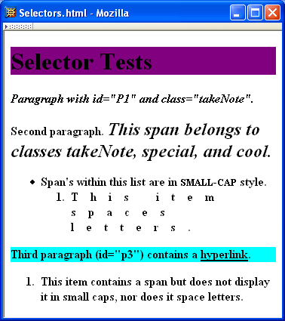
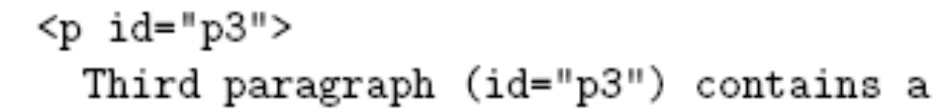
CSS Syntax:
Selector Strings

Slide 19
CSS Syntax:
Selector Strings
Elements belonging to a style class:
  Referencing a style class in HTML:
Elements of a certain type and class:
class selector

Slide 20
CSS Syntax:
Selector Strings
Elements belonging to a style class:
  Referencing a style class in HTML:
Elements of a certain type and class:
this span belongs to three style classes

Slide 21
CSS Syntax:
Selector Strings
Elements belonging to a style class:
  Referencing a style class in HTML:
Elements of a certain type and class:
this rule applies only to span’s belonging to class special

Slide 22
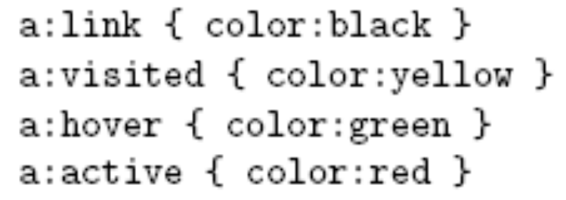
CSS Syntax:
Selector Strings
Source anchor elements:
Element types that are descendents:
pseudo-classes

Slide 23
CSS Syntax:
Selector Strings
Source anchor elements:
Element types that are descendants:
rule applies to li element that is

Slide 24
CSS Syntax:
Selector Strings
Source anchor elements:
Element types that are descendants:
rule applies to li element that is
part of the content of an ol element

Slide 25
CSS Syntax:
Selector Strings
Source anchor elements:
Element types that are descendants:
rule applies to li element that is
part of the content of an ol element
that is part of the content of a ul element

Slide 26
CSS Syntax
Style rules covered thus far follow ruleset syntax
At-rule is a second type of rule
  Reads style rules from specified URL
  Must appear at beginning of style sheet
URL relative to style sheet URL

Slide 27
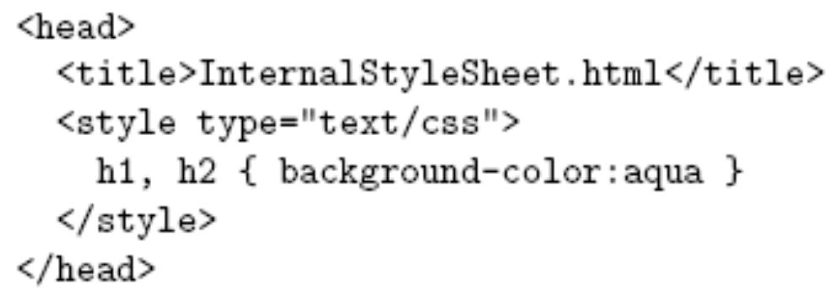
Style Sheets and HTML
Style sheets referenced by link HTML element are called external style sheets
Style sheets can be embedded directly in HTML document using style element
Most HTML elements have style attribute (value is list of style declarations)

Slide 28
Style Sheets and HTML
Rules of thumb:
  Use external style sheets to define site-wide style
  Prefer style sheets (either external or embedded) to style attributes
  XML special characters
    Must use references in embedded style sheets and style attribute
    Must not use references in external style sheets

